Slide 1
UNIT 4

Slide 2
File and File organization
The File is a collection of records. Using the primary key, we can access the records.
The type and frequency of access can be determined by the type of file organization which was used for a given set of records.
File organization is a logical relationship among various records. This method defines how file records are mapped onto disk blocks.
File organization is used to describe the way in which the records are stored in terms of blocks, and the blocks are placed on the storage medium.
The first approach to map the database to the file is to use several files and store only one fixed-length record in any given file.
An alternative approach is to structure our files so that we can contain multiple lengths for records.
Files of fixed-length records are easier to implement than files of variable-length records.

Slide 3
The objective of file organization
It contains an optimal selection of records, i.e., records can be selected as fast as possible.
Performing inserting, deleting, or updating transactions on the records should be quick and easy.
The duplicate records cannot be induced due to inserting, updating, or deleting.
For the minimal cost of storage, records should be stored efficiently.

Slide 4
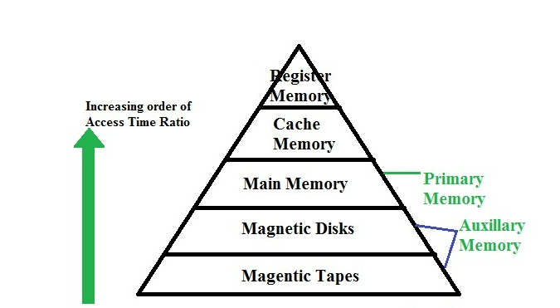
The collection of data that makes up a computerized database must be stored on a storage medium.
The DBMS software can then retrieve, update and process this data as needed.
Computer storage media form a storage hierarchy that includes two main categories:
Primary Storage
Secondary storage
Memory hierarchy and Storage devices

Slide 5
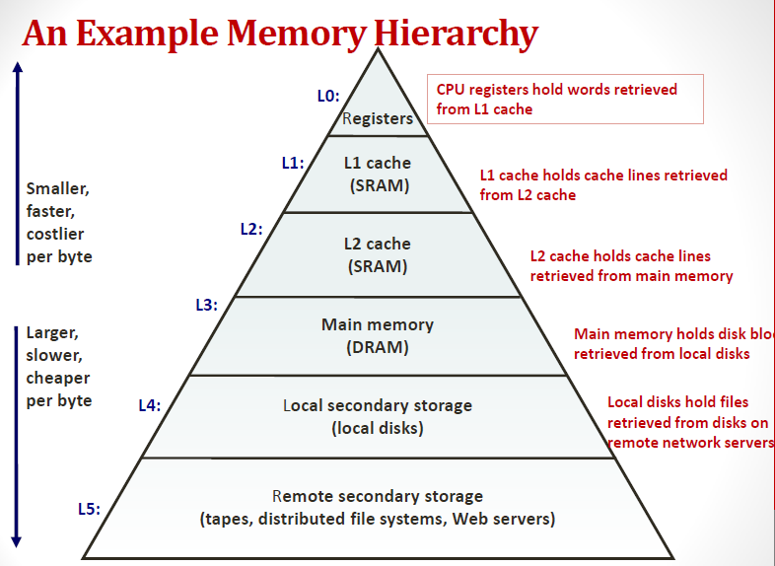

Slide 6
Storage of Databases
Databases store large amounts of data that persist over long periods of time and data is accessed repeatedly during this period.
Most databases are stored permanently on magnetic disk storage devices because:
a) Generally, databases are too large to fit entirely in the main memory.
b) The circumstances that cause permanent loss of stored data arise less frequently for disk secondary storage than for primary storage. Thus, secondary storage is non-volatile and main memory is volatile.
c) The cost of storage per unit of data is an order of magnitude less for disk than for primary storage
Databases reside at different levels of the memory hierarchy.
Data stored on tapes is offline i.e., some intervention is required by the operator. In contrast, disks are online devices that can be accessed directly at any time.

Slide 7
Storage of Databases
The techniques used to store large amounts of structured data on disk are important for database designers, the DBA, and the implementers of DBMS.
Database designers and DBA must know the advantages and disadvantages of each storage technique when they design, implement, and operate a database on a specific DBMS.

Slide 8
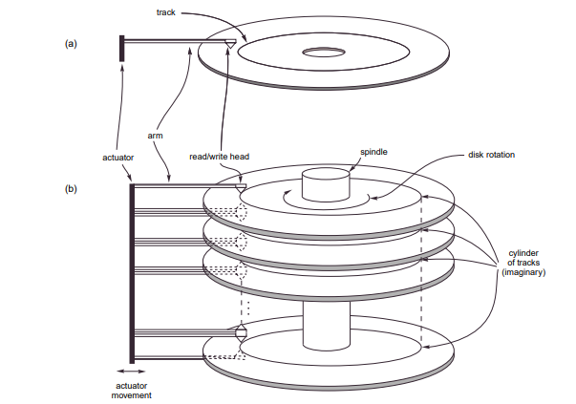
Secondary storage devices
Magnetic Disks

Slide 9
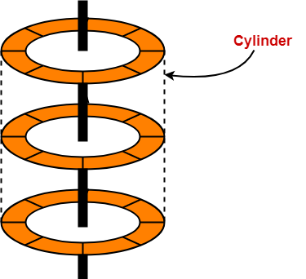
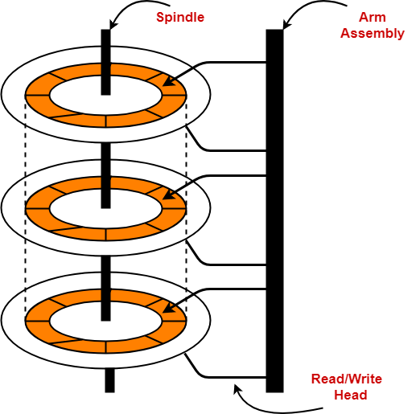
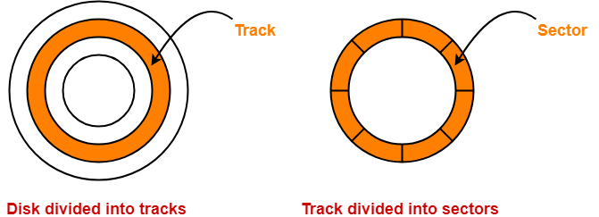
Architecture

Slide 10
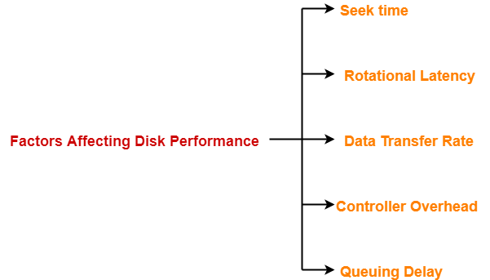
Disk Performance Parameters
The time taken by the read / write head to reach the desired track is called seek time.
The time taken by the desired sector to come under the read / write head is called rotational latency.
The amount of data that passes under the read / write head in a given amount of time is called as data transfer rate.
The overhead imposed by the disk controller is called controller overhead.
Disk controller is a device that manages the disk.
The time spent waiting for the disk to become free is called a queuing delay.
All the tracks of a disk have the same storage capacity

Slide 11
Important Formulas
Capacity of a disk pack
= Total number of surfaces x Number of tracks per surface x Number of sectors per track x Storage capacity of one sector
Disk Access Time
= Seek time + Rotational delay + Transfer time + Controller overhead + Queuing delay
Formatting overhead
= Number of sectors x Overhead per sector
Average disk access time
= Average seek time + Average rotational delay + Transfer time + Controller overhead + Queuing delay
Formatted disk space
= Total disk space or capacity – Formatting overhead
Average seek time
= 1 / 3 x Time taken for one full stroke
Storage density of a track
= Capacity of the track / Circumference of the track
Average rotational latency
= 1 / 2 x Time taken for one full rotation
Capacity of a track
= Recording density of the track x Circumference of the track
Data transfer rate
= Number of heads x Bytes that can be read in one full rotation x Number of rotations in one second
Total number of tracks per surface
= (Outer radius – Inner radius) / Inter track gap

Slide 12
Points to Remember-
The entire disk space is not used for storage because some space is wasted in formatting.
When rotational latency is not given, use average rotational latency for solving numerical problems.
When seek time is not given, use average seek time for solving numerical problems.
It is wrong to say that as we move from one track to another away from the center, the capacity increases.
All the tracks have the same storage capacity.

Slide 13
Buffering of Blocks
When Several blocks need to be transferred from the main memory and all block addresses are known, several buffers can be reserved in the main memory to speed up the transfer.
When one buffer is read or written then the CPU can process data in the other buffer.
This is done by a disk I/O processor which is independent and can proceed transfer of data block.
Processes can execute either in an interleaved way or can be processed in parallel.
Parallel execution is not possible with a single CPU although interleaved execution is possible.
Buffering is useful for the parallel execution of processes that are carried out either with a separate disk I/O processor or multiple CPU processors exist.
The CPU can start processing a block once it is transferred to the main memory and at the same time disk I/O processor can read and transfer the next block into the next buffer-DOUBLE BUFFERING
Double buffering permits continuous reading or writing of data on consecutive disk blocks which eliminates seek time and rotational delay for all but the first block transfer.

Slide 14
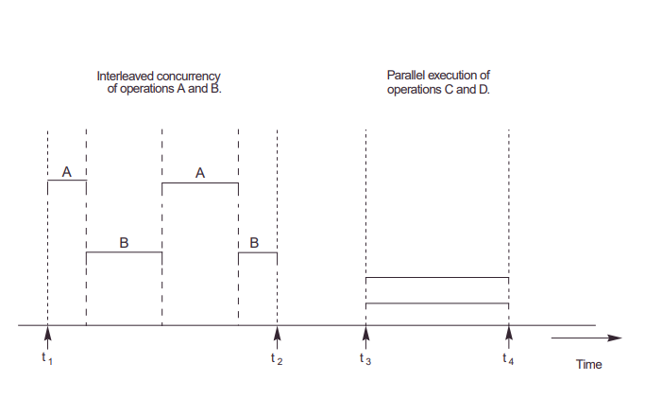

Slide 15
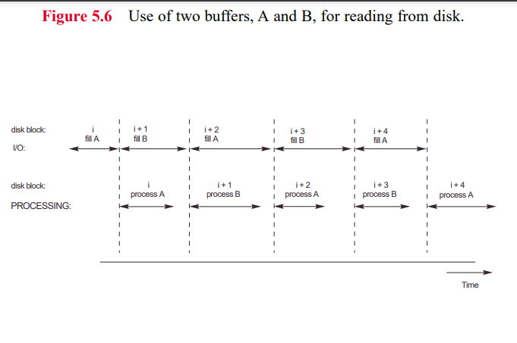

Slide 16
Placing File records on disk
Record and Record Types
In databases, data is stored in the form of records that consist of data values or items.
The data items are formed of bytes and correspond to the field of the record.
Field names + data types=Record type or record format.
Field datatypes are the standard data types such as string, numeric, boolean etc.
In, the latest database applications, the data items may be unstructured objects, that represent images, digitized video or audio streams, or free text. These are referred to as BLOBs (Binary large objects).
A BLOB data item is stored separately from its record in a pool of disk blocks, and a pointer to the BLOB is included in the record.

Slide 17
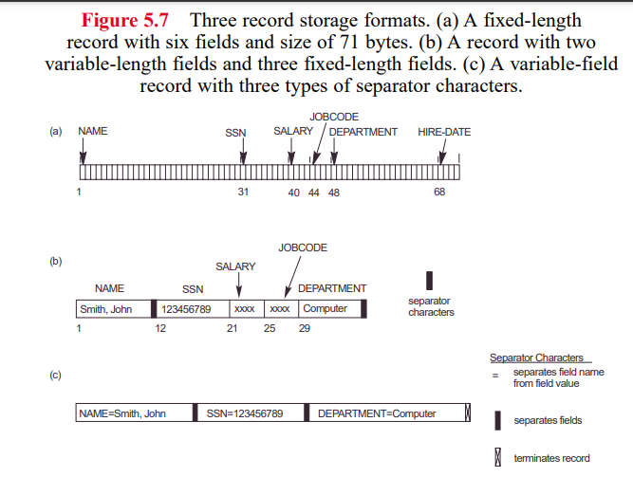
Files, Fixed-length records and variable length records

Slide 18
Operations and Files
File operations
Retrieval operations
(Do not change data in a file)
Update operations
(Change the file by insertion or deletion of records)
To perform operations on file we may have to select the records based on a selection condition (or filtering condition).
Employee file: NAME, SSN, SALARY, JOB CODE, and DEPARTMENT-→ Simple selection condition (SSN=‘123456789’)
-→ Complex condition (Salary>= 3000)

Slide 19
When several file records satisfy a search condition, the first record with respect to the physical sequence of records is located and designated as a CURRENT RECORD.
SET of REPRESENTATIVE OPERATIONS:
1) OPEN: Prepares the file for reading or writing. Allocates appropriate buffers to hold file blocks from the disk and retrieves the file header. Sets the file pointer to the beginning of the file.
2) RESET: Sets the file pointer of an open file to the beginning of the file.
3) FIND (or LOCATE): Searches for the first record that satisfies the condition. Transfers the block containing that record into the main memory buffer. The file pointer points to the record in the buffer, and it becomes the current record.
4) Read (or GET): copies the current record from the buffer to a program variable in the user program. This command may also advance the current record pointer to the next record in the file, which may necessitate reading the next file block from the disk.
5) FINDNEXT: Searches for the next record in the file that satisfies the search condition. Transfers the block containing that record into the main memory buffer which now becomes the current record.
6) DELETE: the current record is deleted and the file on disk is updated to reflect the deletion.

Slide 20
7)MODIFY: modifies some field values of the current record and updates the file on disk to reflect the modification.
8) INSERT: Insert a new record in the file by locating the block where the record is to be inserted, transferring the block into the main memory buffer, writing the record into the buffer, and writing the buffer to the disk to reflect the insertion.
9) CLOSE: Complete the file access by releasing the buffers and performing any other needed cleanup operations.

Slide 21

Introduction to file structures

Slide 22
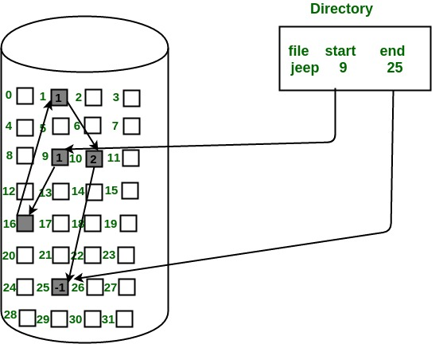
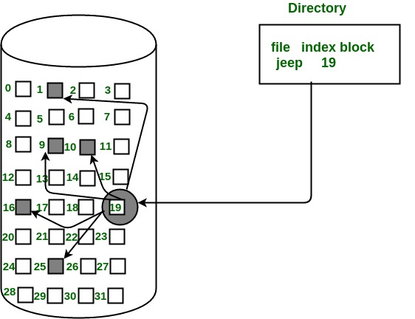
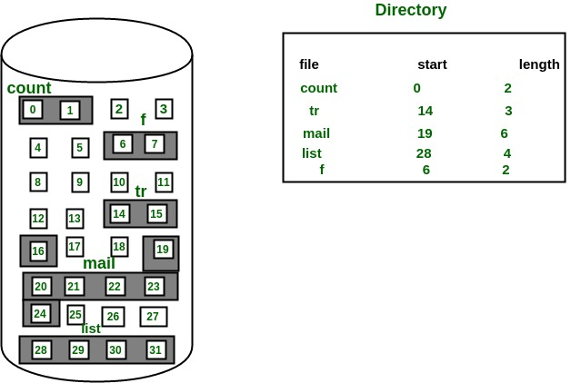
File Structures
A file is a data structure like other data structures such as arrays, stacks, etc. However, files are treated and managed in a slightly different way.
The insertion and deletion in the other data structures is pre-defined and fixed, although it is not so in case of files.
We have certain file systems to handle files as NTFS etc. and the file handling methods include:
Contiguous allocation
b) Linked allocation
c) Index allocation

Slide 23
File Structures
A file can have a variable number of rows and columns and can be stored in the different blocks of the disk.
A table is called a relation because it is a mathematical relation, and it is a subset of a cartesian product i.e., the table is itself a set which is an unordered structure.
This means the order of rows and columns does not matter or it is insignificant. However, we can store files either in a sorted or unsorted way.
Sorted File | Unsorted File
Can be sorted according to one attribute only (search key) | Random order, any record can be placed any where
Fast searching (Binary search) | Searching will be slow
Insertion and deletion is difficult | Insertion and deletion is easy.

Slide 24
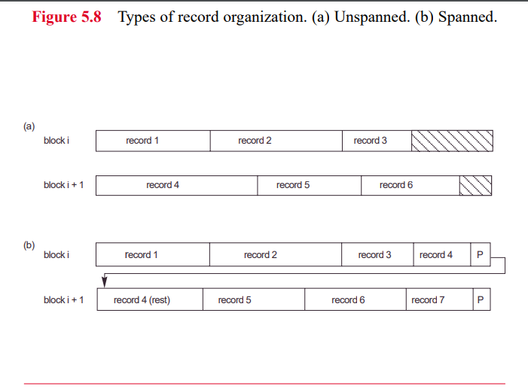

Slide 25
File Organization
File organization is a logical relationship among various records. This method defines how file records are mapped onto disk blocks.
File organization is used to describe the way in which the records are stored in terms of blocks, and the blocks are placed on the storage medium.
Objective of file organization
It contains an optimal selection of records, i.e., records can be selected as fast as possible.
To perform insert, delete or update transaction on the records should be quick and easy.
The duplicate records cannot be induced as a result of insert, update or delete.
For the minimal cost of storage, records should be stored efficiently.

Slide 26
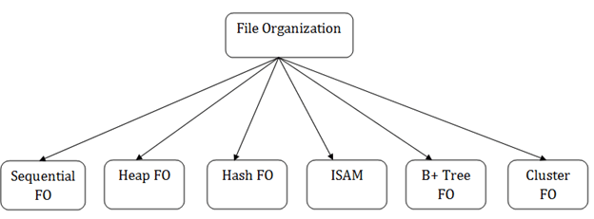
Types of file organization

Slide 27
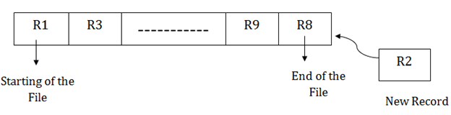
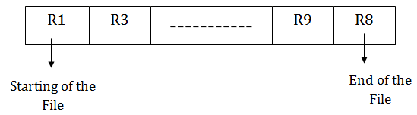
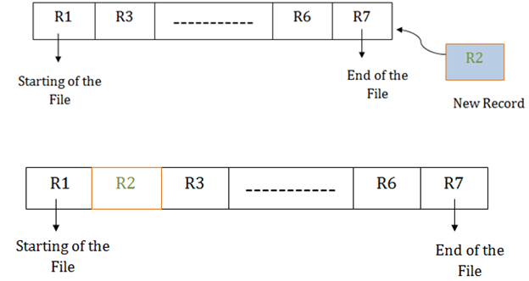
Sequential File Organization
Pile File Method:
Sorted File Method:

Slide 28
Pros of sequential file organization
It contains a fast and efficient method for the huge amount of data.
In this method, files can be easily stored in cheaper storage mechanism like magnetic tapes.
It is simple in design. It requires no much effort to store the data.
This method is used when most of the records must be accessed like grade calculation of a student, generating the salary slip, etc.
This method is used for report generation or statistical calculations.
Cons of sequential file organization
It will waste time as we cannot jump on a particular record that is required but we have to move sequentially which takes our time.
Sorted file method takes more time and space for sorting the records.

Slide 29
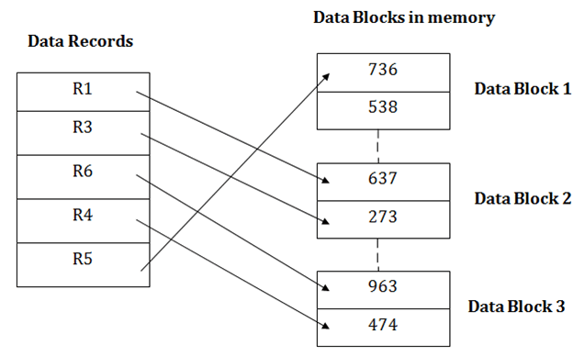
Heap file organization
Stored as data blocks.
Rows are appended at the end of the heap file as they are inserted. Hence the file is unordered.
Deleted rows create gaps in the file. File must be periodically compacted to recover space.
Heap file performances:
Assume file containing F pages
Inserting a row:
Access path is scanned
Average F/2 transfers if row already exists.
F+1 page transfer if row does not already exist.
Deleting a row:
Access path is scanned
Average F/2+1 transfers if row already exists.
F+1 page transfer if row does not already exist.

Slide 30
Query:
Access path is scanned
Organization is efficient if any query returns all rows and order of access is not important. (Select *from product)
Organization is inefficient if a unique row is requested. (Select * from product where PID=‘P101’)
Organization is inefficient if subset of rows is requested. All F pages are to be read. (Select * from product where price <=500 and >=1500)
P001 | Prod1 | 500
P005 | Prod5 | 600
P004 | Prod4 | 570
P010 | Prod10 | 650
P009 | Prod 9 | 780
P008 | Prod 8 | 450
Page 0
P002 | Prod2 | 800
P011 | Prod11 | 1600
P003 | Prod3 | 400
P006 | Prod 6 | 870
Page 1
Product details stored in heap file

Slide 31
Pros of Heap file organization
It is a very good method of file organization for bulk insertion. If there is many data which needs to load into the database at a time, then this method is best suited.
In case of a small database, fetching and retrieving of records is faster than the sequential record.
Cons of Heap file organization
This method is inefficient for the large database because it takes time to search or modify the record.
This method is inefficient for large databases.

Slide 32
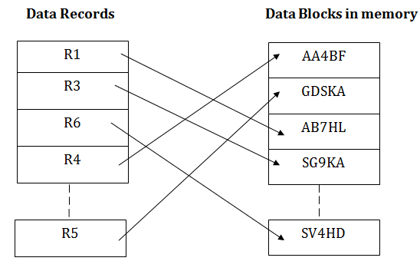
Hash File Organization
Hash File Organization uses the computation of hash function on some fields of the records. The hash function's output determines the location of disk block where the records are to be placed.
Retrieving a record:
When a record must be received using the hash key columns, then the address is generated, and the whole record is retrieved using that address

Slide 33
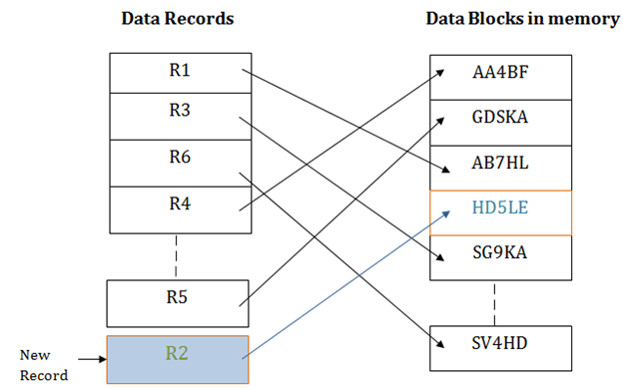
Inserting, Updating and deleting records:
When a new record must be inserted, then the address is generated using the hash key and record is directly inserted. The same process is applied in the case of delete and update.
In this method, there is no effort for searching and sorting the entire file. In this method, each record will be stored randomly in the memory.

Slide 34
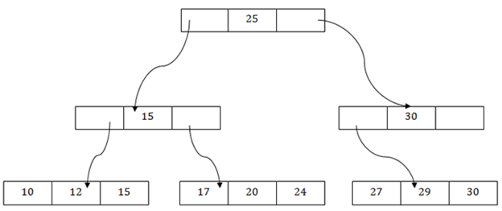
B+ File Organization
B+ tree file organization is the advanced method of an indexed sequential access method. It uses a tree-like structure to store records in File.
It uses the same concept of key-index where the primary key is used to sort the records. For each primary key, the value of the index is generated and mapped with the record.
The B+ tree is like a binary search tree (BST), but it can have more than two children. In this method, all the records are stored only at the leaf node. Intermediate nodes act as a pointer to the leaf nodes. They do not contain any records.

Slide 35
Pros of B+ tree file organization
In this method, searching becomes very easy as all the records are stored only in the leaf nodes and sorted the sequential linked list.
Traversing through the tree structure is easier and faster.
The size of the B+ tree has no restrictions, so the number of records can increase or decrease and the B+ tree structure can also grow or shrink.
It is a balanced tree structure, and any insert/update/delete does not affect the performance of tree.
Cons of B+ tree file organization
This method is inefficient for the static method.

Slide 36
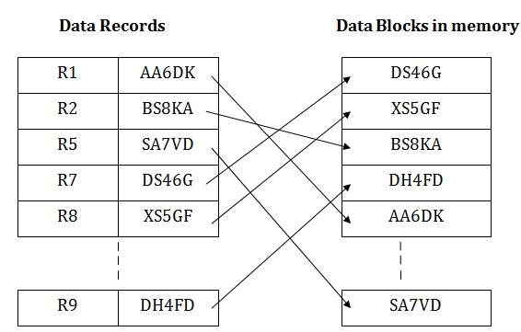
Indexed sequential access method (ISAM)
ISAM method is an advanced sequential file organization. In this method, records are stored in the file using the primary key.
An index value is generated for each primary key and mapped with the record.
This index contains the address of the record in the file.
If any record must be retrieved based on its index value, then the address of the data block is fetched, and the record is retrieved from the memory

Slide 37
Pros of ISAM:
In this method, each record has the address of its data block, searching a record in a huge database is quick and easy.
This method supports range retrieval and partial retrieval of records. Since the index is based on the primary key values, we can retrieve the data for the given range of value.
In the same way, the partial value can also be easily searched, i.e., the student's name starting with 'JA' can be easily searched.
Cons of ISAM
This method requires extra space in the disk to store the index value.
When the new records are inserted, then these files must be reconstructed to maintain the sequence.
When the record is deleted, then the space used by it needs to be released. Otherwise, the performance of the database will slow down.

Slide 38
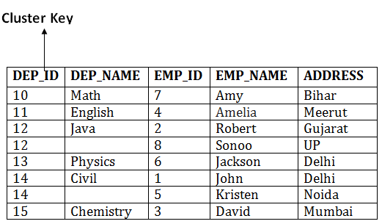
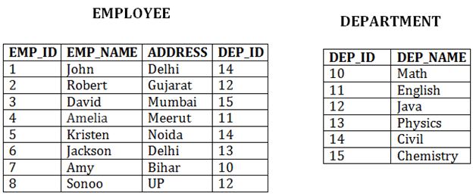
Cluster file organization
When the two or more records are stored in the same file, it is known as clusters. These files will have two or more tables in the same data block, and key attributes which are used to map these tables together are stored only once.
This method reduces the cost of searching for various records in different files.
The cluster file organization is used when there is a frequent need for joining the tables with the same condition. These joins will give only a few records from both tables. In the given example, we are retrieving the record for only particular departments. This method can't be used to retrieve the record for the entire department.

Slide 39
In this method, we can directly insert, update or delete any record. Data is sorted based on the key with which searching is done. Cluster key is a type of key with which joining of the table is performed.
Types of Cluster file organization:
Cluster file organization is of two types:
1. Indexed Clusters:
In indexed cluster, records are grouped based on the cluster key and stored together. The above EMPLOYEE and DEPARTMENT relationship is an example of an indexed cluster. Here, all the records are grouped based on the cluster key- DEP_ID and all the records are grouped.
2. Hash Clusters:
It is like the indexed cluster. In hash cluster, instead of storing the records based on the cluster key, we generate the value of the hash key for the cluster key and store the records with the same hash key value.

Slide 40
Pros of Cluster file organization
The cluster file organization is used when there is a frequent request for joining the tables with same joining condition.
It provides the efficient result when there is a 1:M mapping between the tables.
Cons of Cluster file organization
This method has the low performance for the very large database.
If there is any change in joining condition, then this method cannot use. If we change the condition of joining, then traversing the file takes a lot of time.
This method is not suitable for a table with a 1:1 condition.

Slide 41
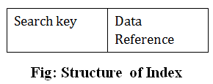
Indexing in DBMS
Indexing is used to optimize the performance of a database by minimizing the number of disk accesses required when a query is processed.
The index is a type of data structure. It is used to quickly locate and access the data in a database table.
Index structure:
Indexes can be created using some database columns.
Search Key or anchor attribute
Contains base address of the block
B1
Roll No. | Block ptr.
→10,000 records and 1000 blocks
No. of records in each block 10
File may be sorted or unsorted
B2
B3

Slide 42
To search a record for ex. 9452 in a sorted file we can use binary search to find the block and as it is binary search log2n➔ log 2 1000 ~=10.
This means that in the worst case of binary search, we must access 10 blocks to find the desired block.
If the file is unsorted, then in a worst-case scenario we must access 1000 blocks.
Now to find the solution we use indexing. It is like the index of the book present at the back and is used to reduce the search time.
Index file consists of two fields – 1) Search Key and 2) Block pointer that stores the base address of the block.
The size of the index file must be much smaller than the database file, only then it will be beneficial to create an index file that is used to reduce the search time.
To reduce the size of the index file (horizontally) we use only one field as the search key or anchor attribute and, we are not providing pointers for each record (vertically).
The type of index in which all the records do not get entries in the index file is called the SPARSE INDEX and the type of index in which all the values of one field get the entries in the index file is called the DENSE INDEX.

Slide 43
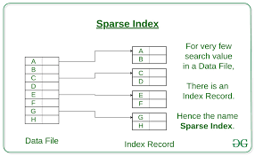
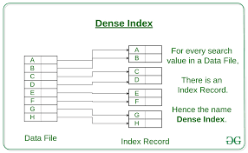
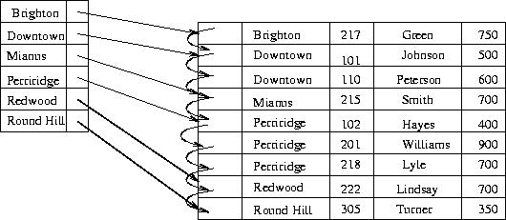
Is it a sparse or dense index?
1
1
1
2
3
3
4
1
2
3
4

Slide 44
In an unsorted file, only dense indexing can be used. This also helps to retrieve the records faster.
The indexing does not impact the structure of the database file i.e., the structure of the database file is independent of the index file.
However, creating and storing the index file involves additional overhead in terms of creation time and storage.
Indexing Methods
Indexing
Single level
Primary Index
Clustering index
Multilevel
Secondary index

Slide 45
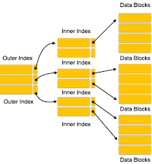
Primary Indexing: We use the primary key as the search key, and it is used in a sorted or ordered file.
Clustered Indexing: In this case, we use the non-key attribute to make a search key and it is also created on a sorted file.
Secondary Indexing: used when the main file is unsorted, and it is a type of dense indexing. Here search key may be a key or non-key attribute.
NOTE: A DATABASE FILE MAY BE SORTED OR UNSORTED BUT THE INDEX FILE IS ALWAYS SORTED ONLY THEN IT IS USEFUL.
In MULTILEVEL INDEXING we create another index on an already created index when the index file is also large.

Slide 46
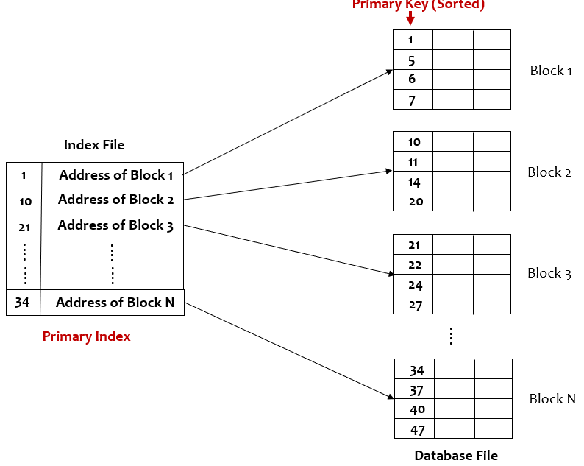
PRIMARY INDEXING
1. Main file is sorted according to the primary key.
2. Primary key is used as the anchor attribute.
3. It is an example of sparse indexing.
4. No. of entries in the index file=No. of blocks acquired in the main file
5. No. of access required=log₂n+1

Slide 47
Is creating a primary index useful or Not?
Time to Access without index
Block size=1024 bytes and record size=100 Bytes, No. of records= 30,000
Blocking factor= Block size/record size
(Blocking factor is the number of records in a block)
= 1024/100 =10.24 =10
(We have taken lower bound as we are using here unspanned mapping)
No. of blocks in main file (n)= No. of records in the main file/blocking factor
= 30,000/10 =3000
In case we do not get an integer value then we will take the upper bound as even if 1 or 2 records are there in the block it is occupied so we will consider it as well.
No. of block access required= log₂n =log₂ 3000 =12
12 is the number of maximum block access that may be required to search a record

Slide 48
Time to Access with index
Block size=1024 bytes and record size=15 Bytes (in index), No. of records= 30,000
Blocking factor= Block size/record size (For index file) (Blocking factor is the number of records in a block)
= 1024/15 =68
No. of blocks in the index file (n)= No. of records in the index file/blocking factor
= 3000/68 =45
No. of block access required= log₂n +1 =log₂ 45 +1 =6+1 =7
7 is the number of maximum block access that may be required to search a record using index
Primary key
 | 100 bytes
 |  | 30,000 records
Index File
Main File
Primary Key | Block pointer
15 KB

Slide 49
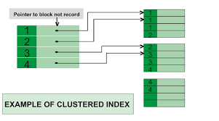
Clustering index
Main file is sorted on the non-key attribute.
Index file contains the value of the non-key attribute and block pointer
There will be one entry for each unique value of the attribute
No. of blocks acquired by index file is n the block access required will be >= log₂n+1

Slide 50
Secondary Indexing
The Main file is unsorted
Can be done on a key as well as non-key attribute.
It is called a secondary index because normally another index is already created.
Example of dense indexing
No. of entries in the index file=No. of entries in the main file.
No. of block access=log₂n+1 (This is for index file)
Main File
Search Key
1 27 3
92 5 2
| |
| |
| |
|
8 100 4
Index File
INDEX FILE
Non-Key attribute | Block pointer
1 2 3
4 5 6
92 -- 100

Slide 51
Is there a use for creating an index file if all the values from the main file are given entries in the index file?
If the secondary index is created on a non-key attribute, then we can have duplicate values. Do all the values get entries in the index file?

Slide 52
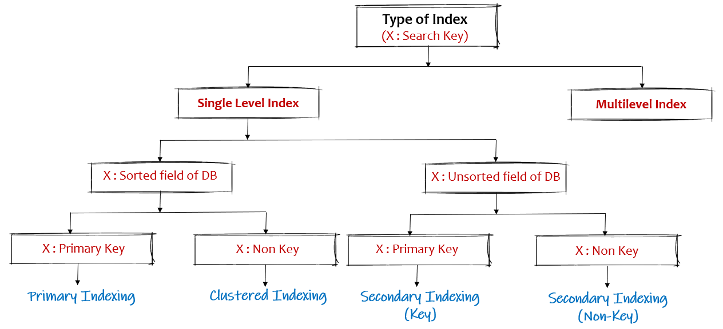

Slide 53
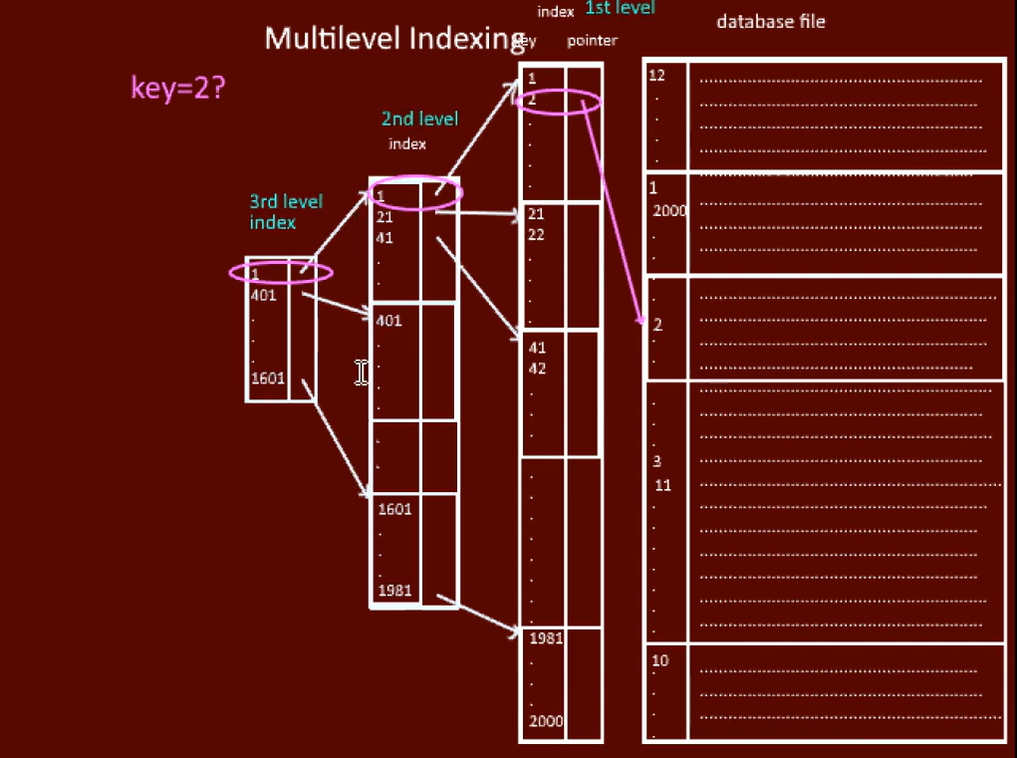

Slide 54
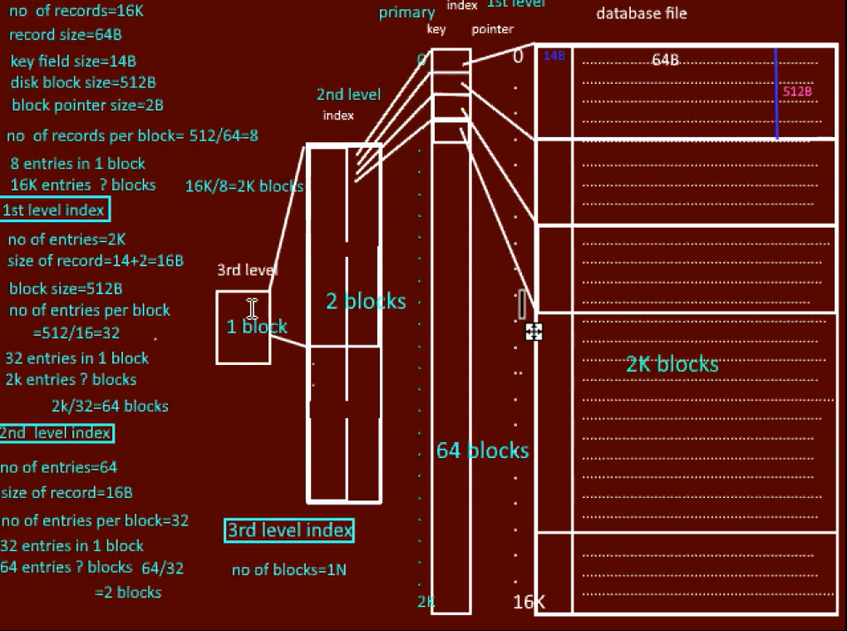

Slide 55
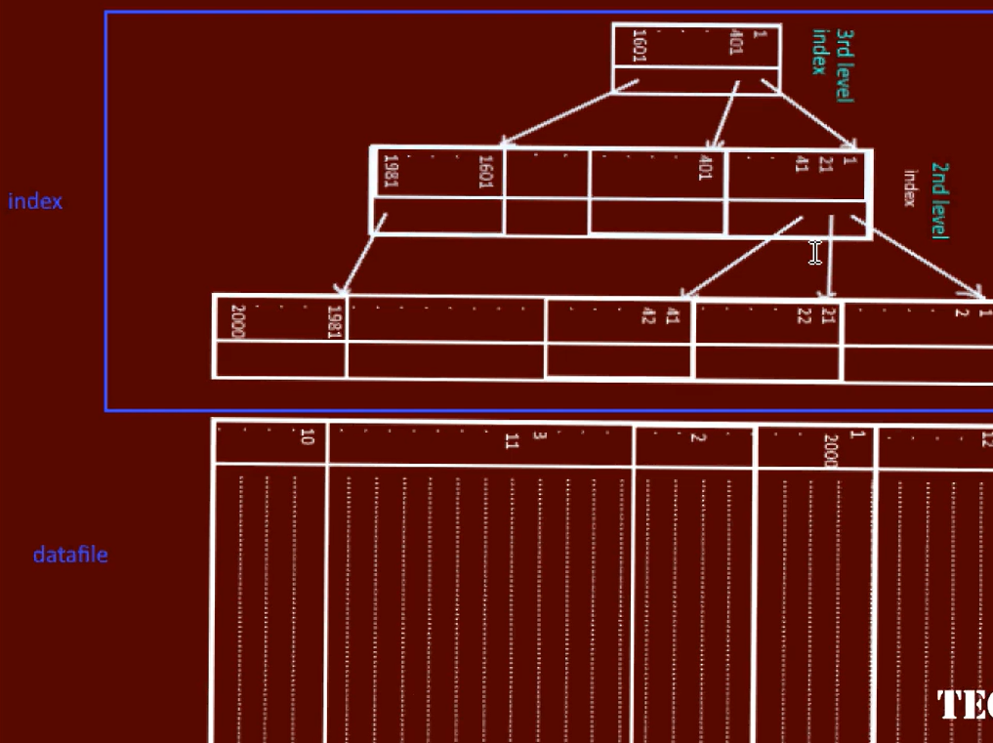

Slide 56
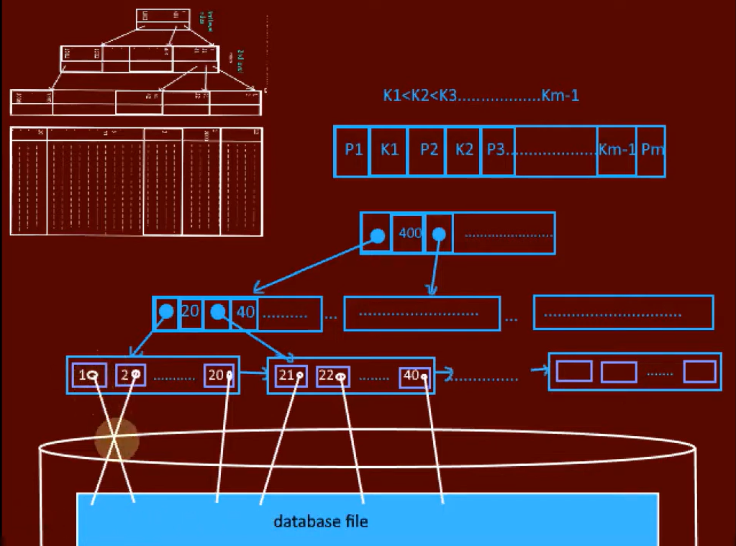

Slide 57
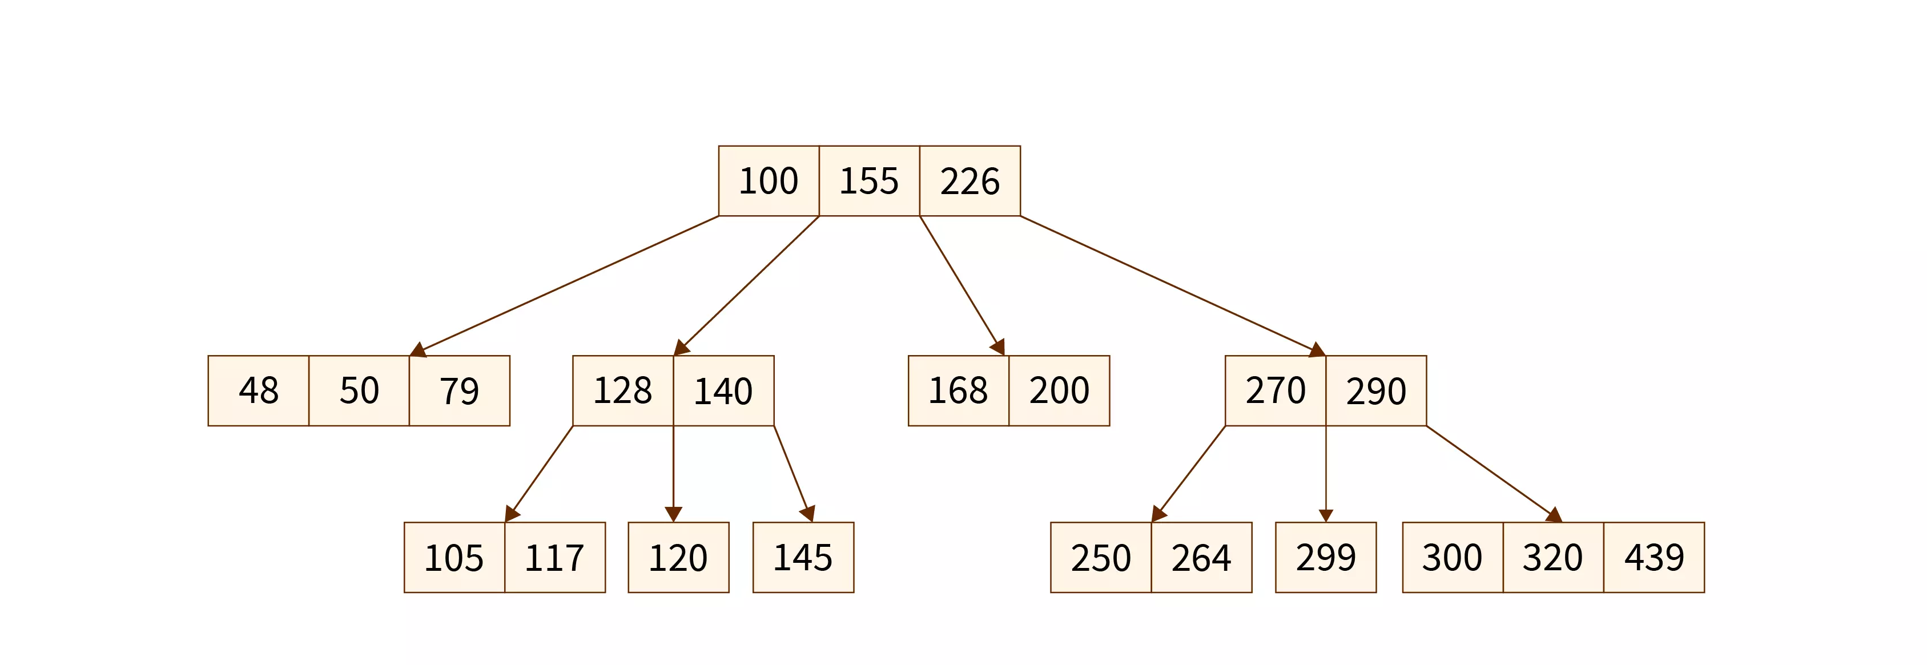
Using B-Trees in indexing
An m-way tree that self-balances itself is called a "B-tree." Due to their balanced structure, such trees are frequently used to manage and organize enormous databases and facilitate searches. In a B-tree, each node can have a maximum of m child nodes.
Definition of B-tree
B-tree in DBMS is an m-way tree that balances itself. Due to their balanced structure, such trees are frequently used to manage and organize enormous databases and facilitate searches.
In a B-tree, each node can have a maximum of n child nodes.
In DBMS, B-tree is an example of multilevel indexing. Leaf nodes and internal nodes will both have record references. B-Tree is called a Balanced stored tree as all the leaf nodes are at the same levels.

Slide 58
Properties of B-tree
Following are some of the properties of B-tree in DBMS:
A non-leaf node's number of keys is one less than the number of its children.
The number of keys in the root ranges from one to (m-1) maximum. Therefore, root has a minimum of two and a maximum of m children.
The keys range from min([m/2]-1) to max(m-1) for all nodes (non-leaf nodes) besides the root. Thus, they can have between m and [m/2] children.
The level of each leaf node is the same.

Slide 59
Need of B-tree
For optimized searching, we cannot increase a tree's height. Therefore, we want the tree to be as short as possible in height.
The use of a B-tree in DBMS, which has more branches and hence a shorter height, is the solution to this problem. Access time decreases as branching and depth grow.
Hence, the use of B-tree is needed for storing data as searching and accessing time is decreased.
The cost of accessing the disc is high when searching tables Therefore, minimizing disc access is our goal.
So, to decrease time and cost, we use B-tree for storing data as it makes the Index Fast.

Slide 60
How Database B-Tree Indexing Works?
When B-tree is used for database indexing, it has both a key and a value. The value serves as a reference to the data record. A payload is a collective term for the key and value.
For indexing data to a particular key and value, the database first constructs a unique random index or a primary key for each of the supplied records. The keys and record byte streams are then all stored on a tree. The random index that is generated is used for indexing the data.
So, this indexing helps to decrease the search time of data.
In a B-tree, all the data is stored on the leaf nodes, now for accessing a particular data index, the database can make use of binary search on the leaf nodes as the data is stored in the sorted order.
If indexing is not used, the database reads each record to locate the requested record and it increases the time and cost of searching the records, so B-tree indexing is very efficient.

Slide 61
How does Searching happen in Indexed Database?
The database does a search in the B-tree for a given key and returns the index in O(log(n)) time. The record is then obtained by running a second B+tree search in O(log(n)) time using the discovered index. So overall approx time taken for searching a record in a B-tree in DBMS Indexed databases is O(log(n)).

Slide 62
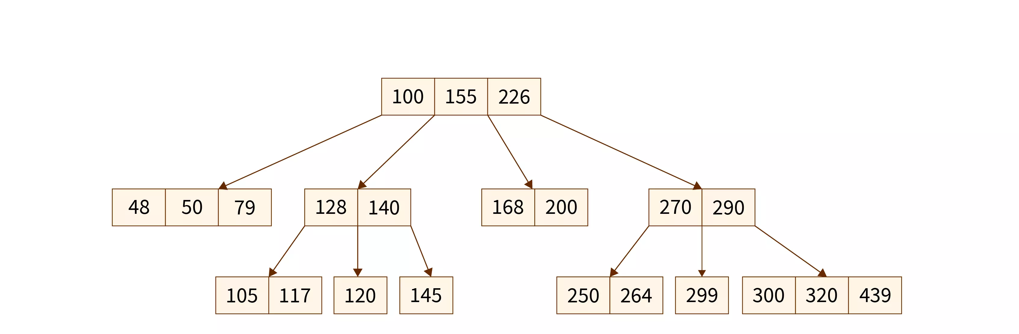
Examples of B-Tree
Suppose there are some numbers that need to be stored in a database, so if we store them in a B-tree in DBMS, they will be stored in sorted order so that the searching time can be logarithmic.
The above data is stored in sorted order according to the values, if we want to search for the node containing the value 48, the following steps will be applied:
First, the parent node with a key having data 100 is checked, as 48 is less than 100 so the left children node of 100 is checked.
In left children, there are 3 keys, so it will check from the leftmost key as the data is stored in sorted order.
The leftmost element is having the key value of 48 which matches the element to be searched, so that’s how we get the element we wanted to search.

Slide 63
Conclusion
An m-way tree that self-balances itself is called a “B-tree”.
Due to their balanced structure, such trees are frequently used to manage and organize enormous databases and facilitate searches.
B-tree is an example of multilevel indexing.
The use of B-tree is needed for storing data as searching and accessing time is decreased.
B-trees can be used for database indexing to improve the searching and storing time of the database.
While using B-tree, the database can make use of binary search on the leaf nodes as the data is stored in sorted order.

Slide 64
What is a B+ Tree?
A B+ Tree is primarily utilized for implementing dynamic indexing on multiple levels. Compared to B- Tree, the B+ Tree stores the data pointers only at the leaf nodes of the Tree, which makes the search process more accurate and faster.
Rules for B+ Tree
Leaves are used to store data records.
It is stored in the internal nodes of the Tree.
If a target key value is less than the internal node, then the point just to its left side is followed.
If a target key value is greater than or equal to the internal node, then the point just to its right side is followed.
The root has a minimum of two children.
Why use B+ Tree
Keys are primarily utilized to aid the search by directing to the proper Leaf.
B+ Tree uses a “fill factor” to manage the increase and decrease in a tree.
In B+ trees, numerous keys can easily be placed on the page of memory because they do not have the data associated with the interior nodes. Therefore, it will quickly access tree data that is on the leaf node.
A comprehensive full scan of all the elements is a tree that needs just one linear pass because all the leaf nodes of a B+ tree are linked with each other.

Slide 65
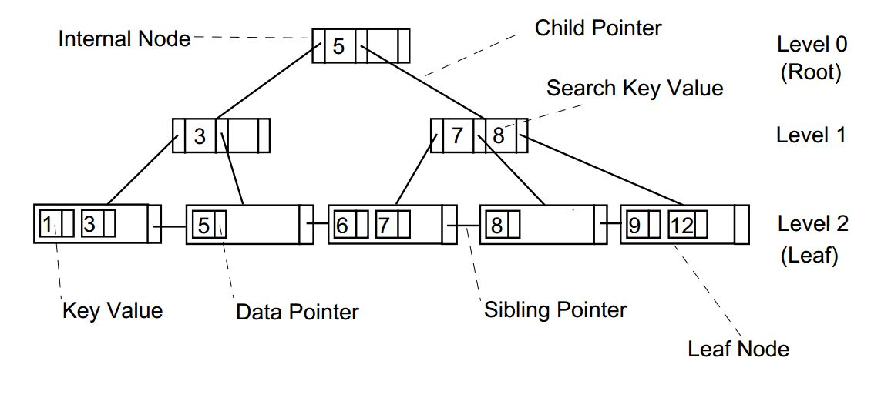

Slide 66
B+ Tree | B Tree
Search keys can be repeated. | Search keys cannot be redundant.
Data is only saved on the leaf nodes. | Both leaf nodes and internal nodes can store data
Data stored on the leaf node makes the search more accurate and faster. | Searching is slow due to data stored on Leaf and internal nodes.
Deletion is not difficult as an element is only removed from a leaf node. | Deletion of elements is a complicated and time-consuming process.
Linked leaf nodes make the search efficient and quick. | You cannot link leaf nodes.

Slide 67
Search Operation
In B+ Tree, a search is one of the easiest procedures to execute and get fast and accurate results from it.
To find the required record, you need to execute the binary search on the available records in the Tree.
In case of an exact match with the search key, the corresponding record is returned to the user.
In case the exact key is not located by the search in the parent, current, or leaf node, then a “not found message” is displayed to the user.
The search process can be re-run for better and more accurate results.

Slide 68
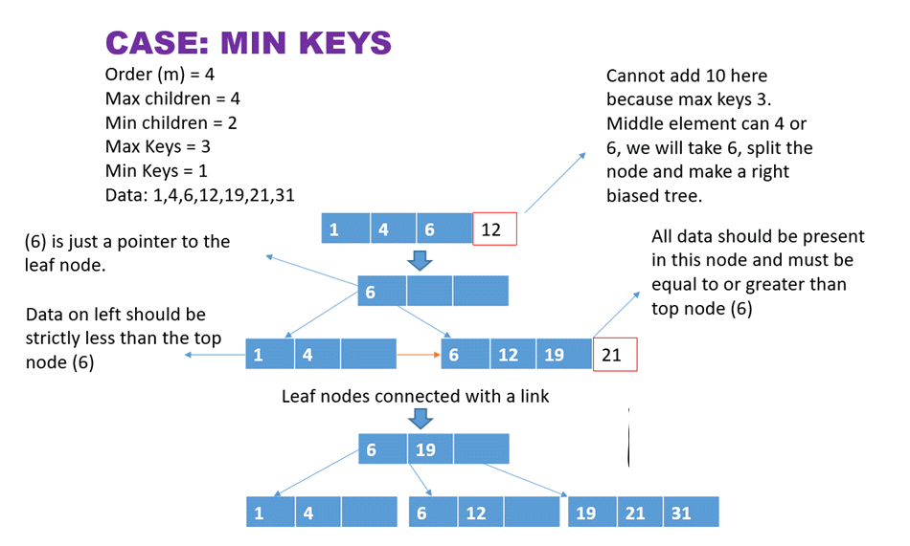
Insert Operation

Slide 69
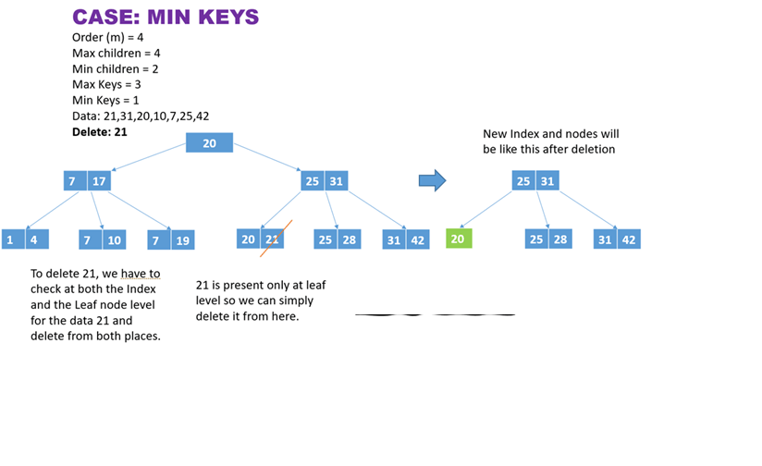
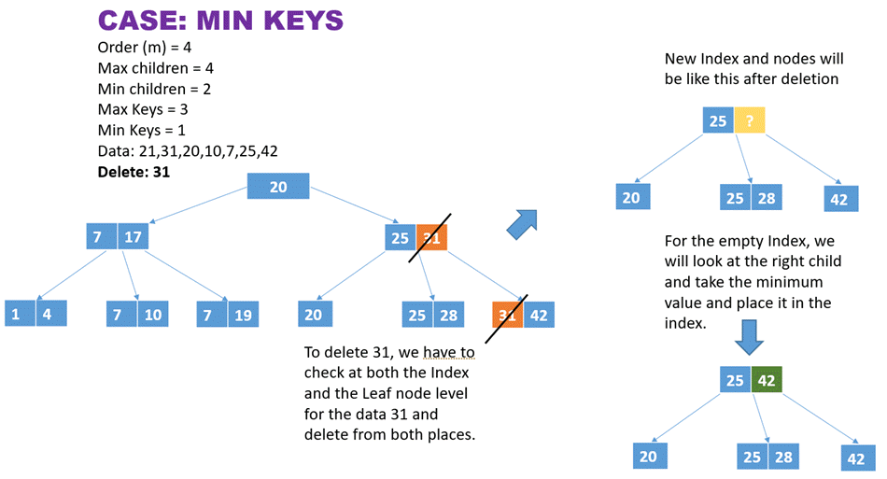
Delete Operation

Slide 70
Summary
B+ Tree is a self-balancing data structure for executing accurate and faster searching, inserting, and deleting procedures on data
We can easily retrieve complete data or partial data because going through the linked tree structure makes it efficient.
The B+ tree structure grows and shrinks with an increase/decrease in the number of stored records.
Storage of data on the leaf nodes and subsequent branching of internal nodes evidently shortens the tree height, which reduces the disk input and output operations, ultimately consuming much less space on the storage devices.

Slide 71
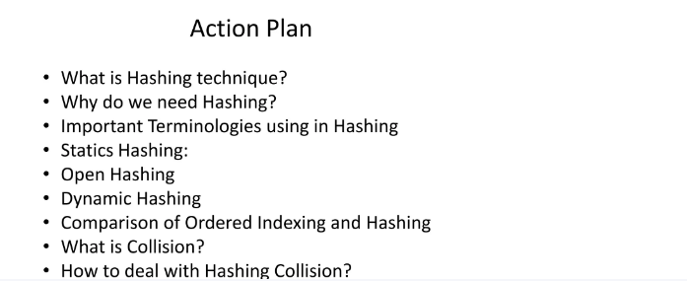

Slide 72
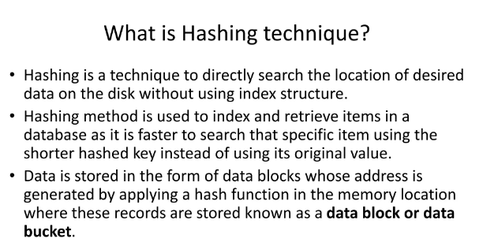

Slide 73
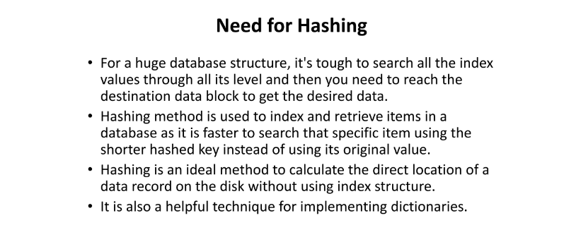

Slide 74
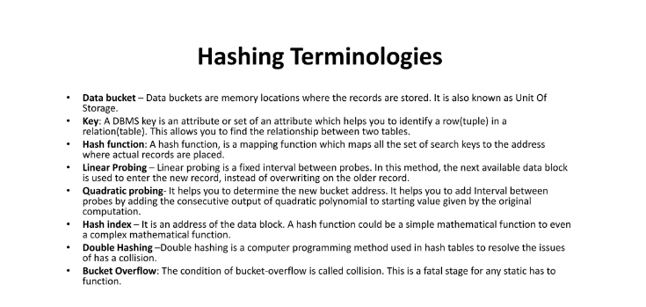

Slide 75
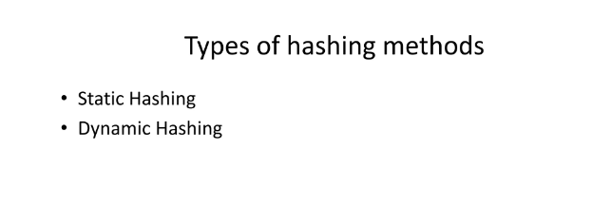
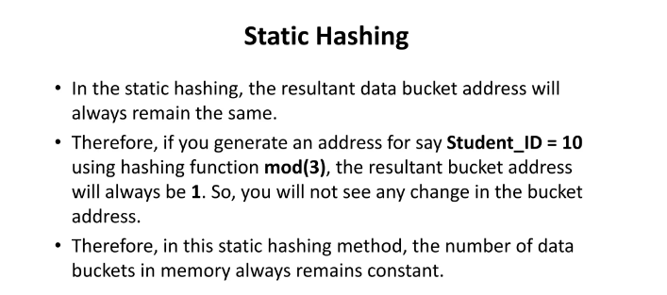

Slide 76
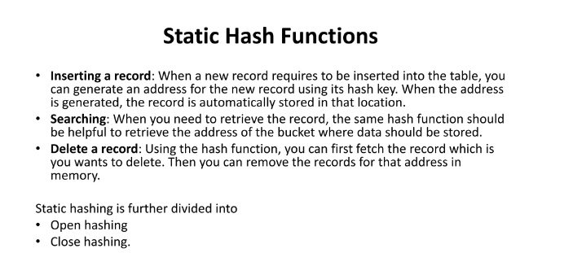

Slide 77


Slide 78



Slide 79


Slide 80


Slide 81


Slide 82


Slide 83


Slide 84


Slide 85


Slide 86


Collision Handling

Slide 87


Slide 88


